Slide 1

IILM UNIVERSITY
ACADEMIC LEARNING REPORT
Greater Noida, Uttar Pradesh
AICTE VIRTUAL INTERNSHIP
INTRODUCTION TO
ARTIFICIAL INTELLIGENCE
An Internship Presentation Report on the Foundations, Reasoning Methods, and Applications of Artificial Intelligence
INTERNSHIP ORGANIZATION
DOMAIN
PRESENTED BY
COMPLETED ON
Kodacy
Introduction to Artificial Intelligence
Mayank Sharma
Roll No.: 2410031163 | Section: 3CSE24
10th September, 2026

Slide 2
CANDIDATE PROFILE Kodacy • AICTE Virtual Internship
Candidate & Internship Overview
Summary of candidate details, internship engagement, and the core learning track.
👤
Candidate & Track Details
✓
Internship Focus Areas
Candidate Name: Mayank Sharma
✓
Foundations of Artificial Intelligence & Intelligent Agents
Roll No.: 2410031163
✓
Problem-Solving through Search & Heuristics
Section: 3CSE24
✓
Knowledge Representation & Logical Reasoning
Host Organization: Kodacy
Probability-Based Decision Making
✓
Domain: Introduction to Artificial Intelligence
Introductory Machine Learning Concepts
✓
Internship Mode: AICTE Virtual Mode
✓
AI Applications, Ethics & Responsible AI
Institution: IILM University, Greater Noida
Introduction to AI | Kodacy • AICTE Virtual Internship
2

Slide 3
ACADEMIC CURRICULUM Kodacy • Structured Learning Program
Internship Profile
Structured learning framework provided by Kodacy for building a strong foundation in AI.
🧠
Artificial Intelligence
📘
Structured Learning Experience
Intelligent Systems
🔍
Search & Reasoning
The internship offered a well-structured curriculum introducing the core ideas of Artificial Intelligence — from intelligent agents and search-based problem solving to knowledge representation, basic learning models, and real-world AI applications.
Through guided modules and conceptual case studies, the programme connected classical AI theory with the way modern intelligent systems are designed and reasoned about.
Problem Solving
📊
Probability & Decisions
Bayesian Thinking
🤖
Intro to Machine Learning
Pattern Recognition
💬
AI Applications
NLP, Vision & Chatbots
Introduction to AI | Kodacy • AICTE Virtual Internship
3

Slide 4
GOALS Key Competency Pillars
Core Learning Objectives
The primary technical pillars established for the Introduction to AI internship.
1
2
3
4
AI Foundations
Agents & Search
Knowledge & Logic
Learning & Ethics
Studying the history, definitions, classifications, and real-world scope of Artificial Intelligence.
Understanding intelligent agents, state-space representation, and heuristic search strategies.
Exploring knowledge representation, inference, and rule-based expert systems.
Introducing basic ML concepts alongside AI applications and responsible AI practice.
Introduction to AI | Kodacy • AICTE Virtual Internship
4

Slide 5
MODULE 01 • AI PRINCIPLES Domain Theory
What is Artificial Intelligence?
Defining intelligence in machines, its evolution, and the two ways AI is classified.
A Brief History of AI
Definition
1956
Term “Artificial Intelligence” coined at the Dartmouth Conference
Artificial Intelligence is the branch of computer science concerned with building systems that can perceive, reason, learn, and act to achieve goals — tasks that would normally require human intelligence.
1980s
Rise of expert systems and rule-based reasoning
1997
Deep Blue defeats a reigning world chess champion
Narrow AI vs. General AI (AGI)
2012
Deep learning breakthroughs revive neural networks
Narrow AI performs a specific task well (voice assistants, recommendation engines). General AI, still theoretical, would match human-level reasoning across any domain.
Today
Generative AI and large language models go mainstream
Introduction to AI | Kodacy • AICTE Virtual Internship
5

Slide 6
MODULE 02 • SEARCH & REASONING Algorithmic Strategy
AI Problem Solving: Agents & Search
How an intelligent agent perceives a problem and searches for an optimal solution.
❓
→
🗺
→
🔎
→
⚖
→
🏁
Problem State
State Space
Search Algorithm
Decision Making
Optimal Solution
Initial definition
All possible states
Heuristic & tree search
Evaluate options
Goal achieved
♟
Types of Intelligent Agents
∑
Search & Decision Techniques
• Simple Reflex Agents — act only on the current percept
• State-space representation & graph traversal
• Goal-Based Agents — act to achieve a defined goal
• Minimax algorithm for adversarial games
• Utility-Based Agents — choose the best outcome
• Probability, conditional likelihood & Bayes’ Theorem
• Learning Agents — improve performance over time
• Naive Bayes for simple classification tasks
Introduction to AI | Kodacy • AICTE Virtual Internship
6

Slide 7
MODULE 03 • COGNITION & SYSTEMS Domain Theory
Knowledge Representation & Reasoning
How AI systems store, structure, and reason over what they know.
🧩
Knowledge Representation
⚖
Logical Reasoning
Semantic networks, frames, and structured schemes for storing facts
Propositional and rule-based logic used to draw valid conclusions
📚
Expert Systems
🛡
Ethical & Responsible AI
Rule-based inference engines that mimic domain-expert decision making
Early exposure to fairness, transparency, and accountability in AI design
Introduction to AI | Kodacy • AICTE Virtual Internship
7

Slide 8
MODULE 04 • A GLIMPSE BEYOND Machine Learning
Introduction to Machine Learning
A brief look at how machines learn patterns from data — the natural next step after classical AI.
1
→
2
→
3
→
4
Raw Data
Feature Study
Model Training
Prediction
Input collection
Variables & labels
Fitting patterns
Output inference
🏷
Learning Paradigms
🧠
Why It Matters for AI
• Supervised Learning — learns from labeled examples
• Gives AI systems the ability to improve with experience
• Unsupervised Learning — finds hidden patterns
• Powers modern applications like recommendations & vision
• Reinforcement Learning — learns via trial and reward
• Foundation for deep learning and neural networks
• Linear & Logistic Regression as starting models
• A natural next step after classical, rule-based AI
Introduction to AI | Kodacy • AICTE Virtual Internship
8

Slide 9
MODULE 05 • APPLIED INTELLIGENCE Contemporary Tech
Applications of Artificial Intelligence
Where the concepts studied show up in everyday intelligent systems.
💬
👁
🤖
Natural Language Processing
Computer Vision
Conversational AI
Chatbots, sentiment analysis, and language understanding
Image classification, object detection & face recognition
Rule-based & LLM-driven chatbot architectures
🏥
🔐
🛡
Healthcare & Industry
Recommendation Systems
AI Safety & Governance
Diagnostics support, automation & assistive AI
Personalized suggestions across e-commerce & media
Responsible deployment and ethical oversight
Introduction to AI | Kodacy • AICTE Virtual Internship
9

Slide 10
ROADMAP 8-Stage Learning Progression
My AI Learning Journey
Sequential curriculum progression traversed throughout the internship at Kodacy.
01
02
03
04
AI Fundamentals
Intelligent Agents
Search Strategies
Probability & Bayes
History, definitions & scope
Agent types & environments
State space & heuristics
Statistical decision making
05
06
07
08
Knowledge & Logic
Expert Systems
Intro to ML
Applications & Ethics
Representation & reasoning
Rule-based inference
Learning paradigms
Real-world AI & governance
Introduction to AI | Kodacy • AICTE Virtual Internship
10

Slide 11
COMPETENCIES Core Skills Acquired
Skills & Knowledge Developed
Summary of conceptual understanding and analytical skills gained across the internship.
🧠
🔎
📊
AI Foundations
Search & Problem Solving
Probability & Bayes
Understanding of intelligent systems, history and the narrow-vs-general AI divide.
State-space search, heuristics, and adversarial game strategies.
Conditional probability, Bayes’ theorem, and simple probabilistic classifiers.
🧩
🤖
🛡
Knowledge & Logic
ML Fundamentals
Ethics & Applications
Representation schemes, logical inference, and expert-system design.
Supervised, unsupervised and reinforcement learning at a conceptual level.
Awareness of responsible AI practice across NLP, vision and automation.
Introduction to AI | Kodacy • AICTE Virtual Internship
11

Slide 12
SUMMARY Academic Internship Takeaways
Internship Experience & Conclusion
Reflective summary of academic growth, practical insight, and future learning pathways.
“
Key Internship Reflections
↗
Future Learning Pathways
The Introduction to AI virtual internship provided a structured, disciplined introduction to how intelligent systems are designed and reasoned about.
Across the programme, I explored agent-based problem solving, search and probability, knowledge representation, and a first look at how machines learn from data — alongside the ethical questions modern AI raises.
→
Applied Machine Learning
Hands-on model building using Python & scikit-learn.
→
Deep Learning Foundations
Neural networks, CNNs and RNNs for vision and language.
→
Advanced & Generative AI
Academic Value: Built a strong conceptual foundation in AI for future coursework and applied ML projects.
Prompt engineering, LLMs and responsible deployment.
Introduction to AI | Kodacy • AICTE Virtual Internship
12

Slide 13
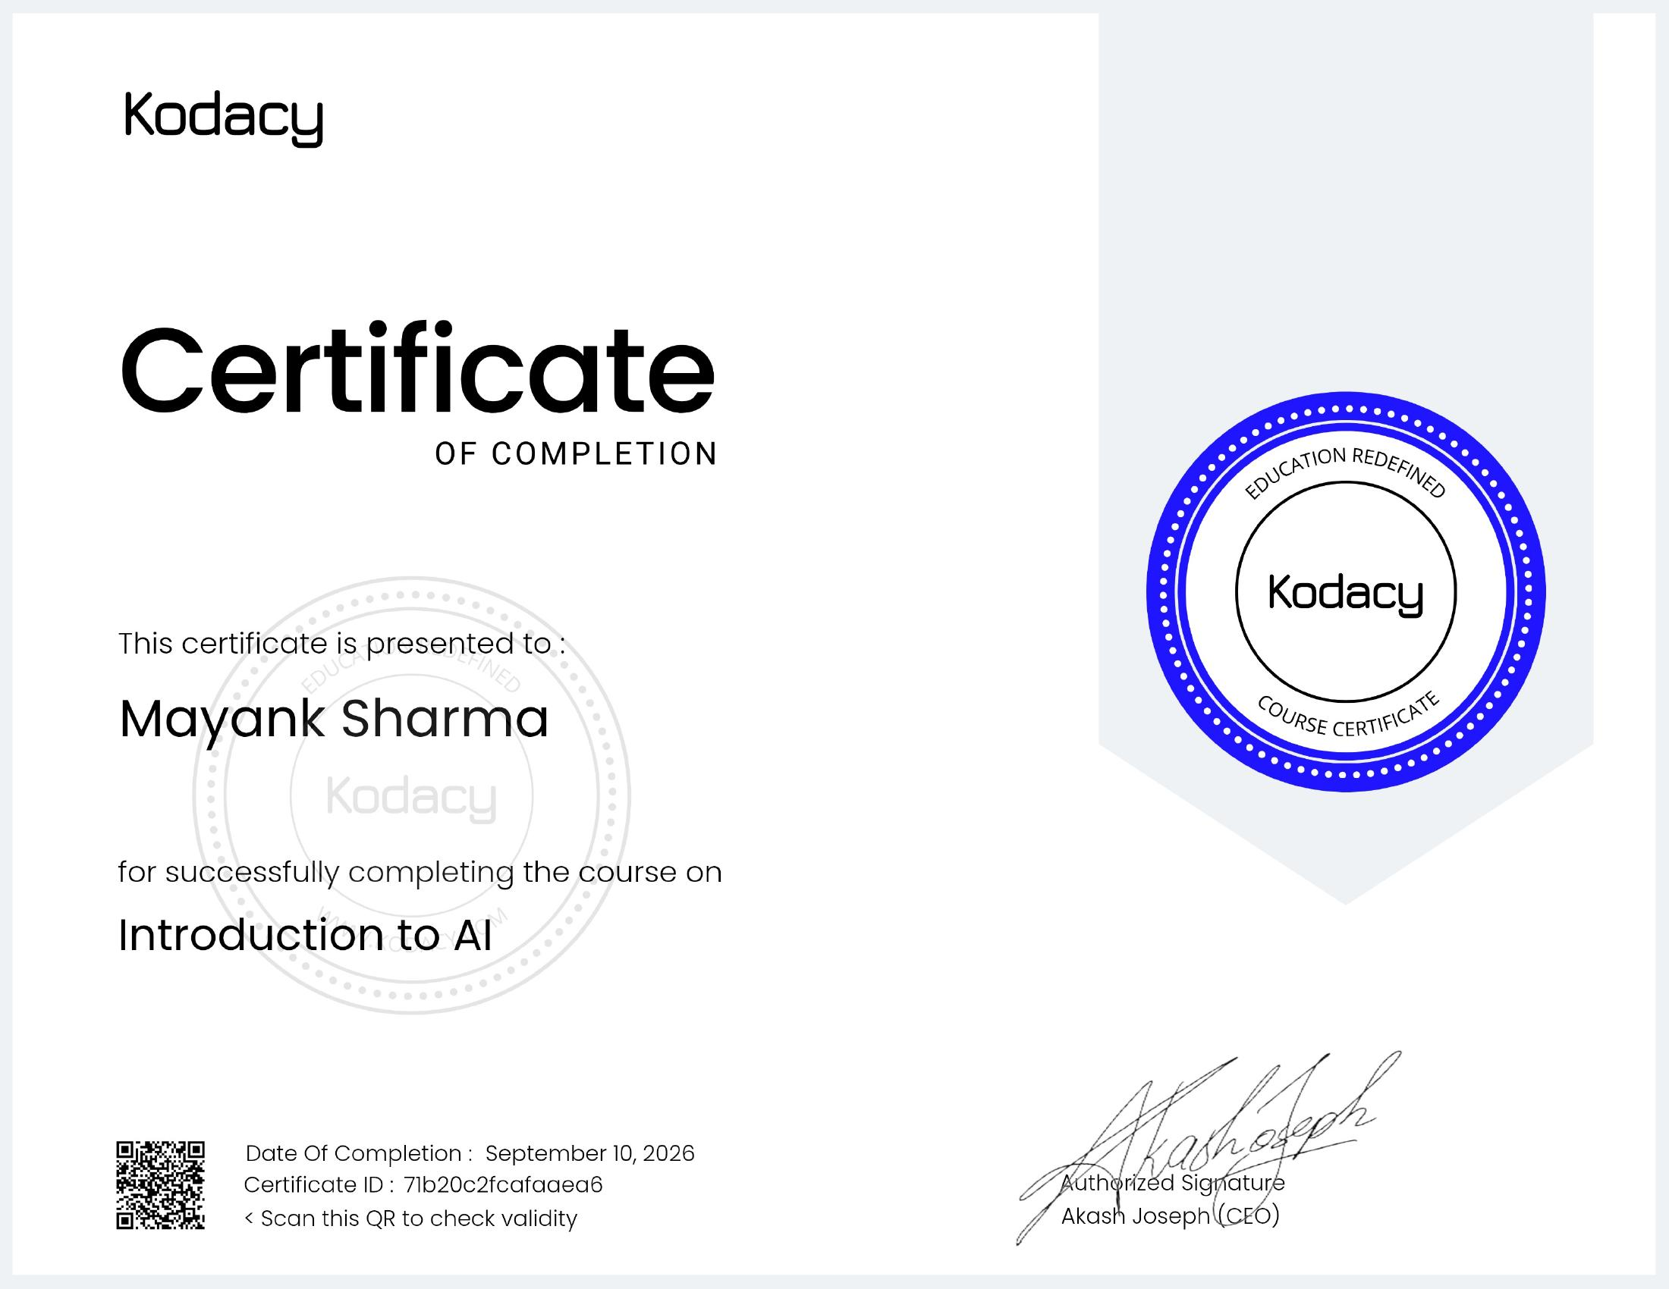
CREDENTIALS Verification & Records
Certificate of Completion
Formal certificate awarded by Kodacy under the AICTE Virtual Internship Programme.
📄
Credential Details
Awarded To: Mayank Sharma
Organization: Kodacy
Domain: Introduction to AI
Program: AICTE Virtual Internship
Status: Successfully Completed
Introduction to AI | Kodacy • AICTE Virtual Internship
13

Slide 14
🎓
Thank You!
Thank you for your time and guidance. Open to questions and academic evaluation.
MAYANK SHARMA
Introduction to AI Intern
Kodacy • IILM University, Greater Noida

